Slide 1


Shree Chanakya Education Society’s
Indira College of Commerce & Science, Wakad, Pune
Project Presentation
“The Medilife”
By,
Pramod M. Deore
Shivprasad S. Ravate
M.Sc.(CA)-II

Slide 2
What is Medilife?
Medilife is an AI-powered healthcare web application that predicts multiple diseases including
Diabetes, Heart Disease, Breast Cancer, CKD, Liver Disease, Malaria, Pneumonia, and Diabetic Retinopathy.
Users can enter medical details or upload medical images like X-rays and blood smear scans to get instant prediction results with confidence scores.
It is built using Flask, Scikit-learn, TensorFlow, PostgreSQL.
The system also includes an AI healthcare chatbot, doctor appointment booking, prediction history, and downloadable reports.

Slide 3
Why it’s needed ?
Unhealthy lifestyles, poor diet, stress, and pollution are driving a rapid rise in chronic diseases.
Manual diagnosis is time-consuming and expensive, requiring repeated hospital visits.
Rural India lacks specialist doctors, making timely medical care inaccessible for millions.
An AI-powered system like Medilife is a must for fast, accessible, and affordable disease screening.

Slide 4
Proposed System
1. User enters symptoms or uploads medical images
2. System preprocesses and validates the data
3. ML/DL models analyze the input
4. Prediction results are generated
5. Results displayed with confidence scores
6. Records stored securely in database

Slide 5
H/W & S/W Requirements
Hardware Requirements :
Intel Core i7 or higher processor
16 GB RAM and 512 GB SSD storage
NVIDIA GPU for Deep Learning tasks
Server with multi-core processor, 4–8 GB RAM, and 50 GB storage
Software Requirements :
Operating Systems: Windows 10/11, Ubuntu Linux, macOS
Technologies: Python 3.10, Flask, HTML, CSS, JavaScript
ML/DL Libraries: Scikit-learn, TensorFlow, Keras, NumPy, Pandas
Database & Tools: PostgreSQL, GitHub, Ollama
Supported Browsers: Google Chrome, Mozilla Firefox, Microsoft Edge

Slide 6
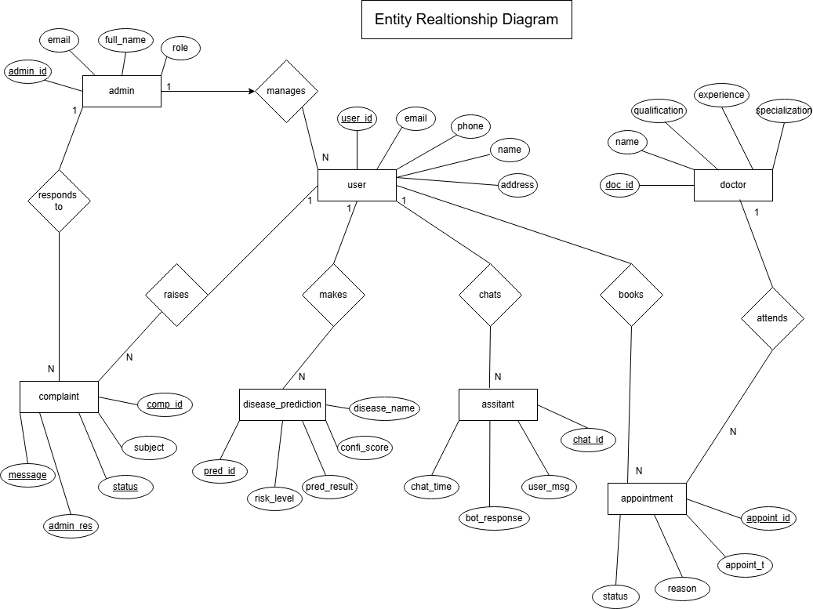
UML Diagrams

Slide 7
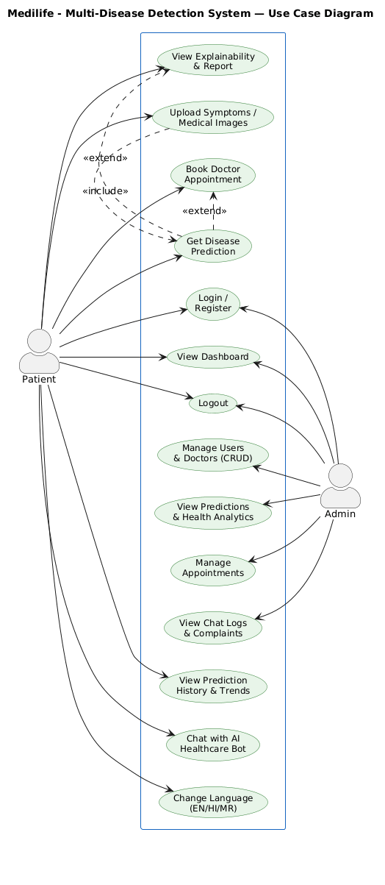
UML Diagrams
Use Case Diagram :

Slide 8
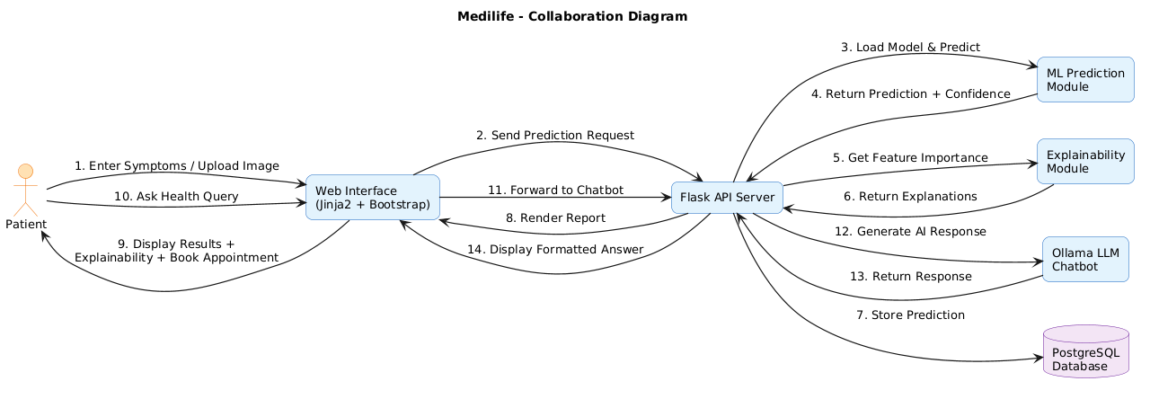
UML Diagrams
Collaboration Diagram :

Slide 9
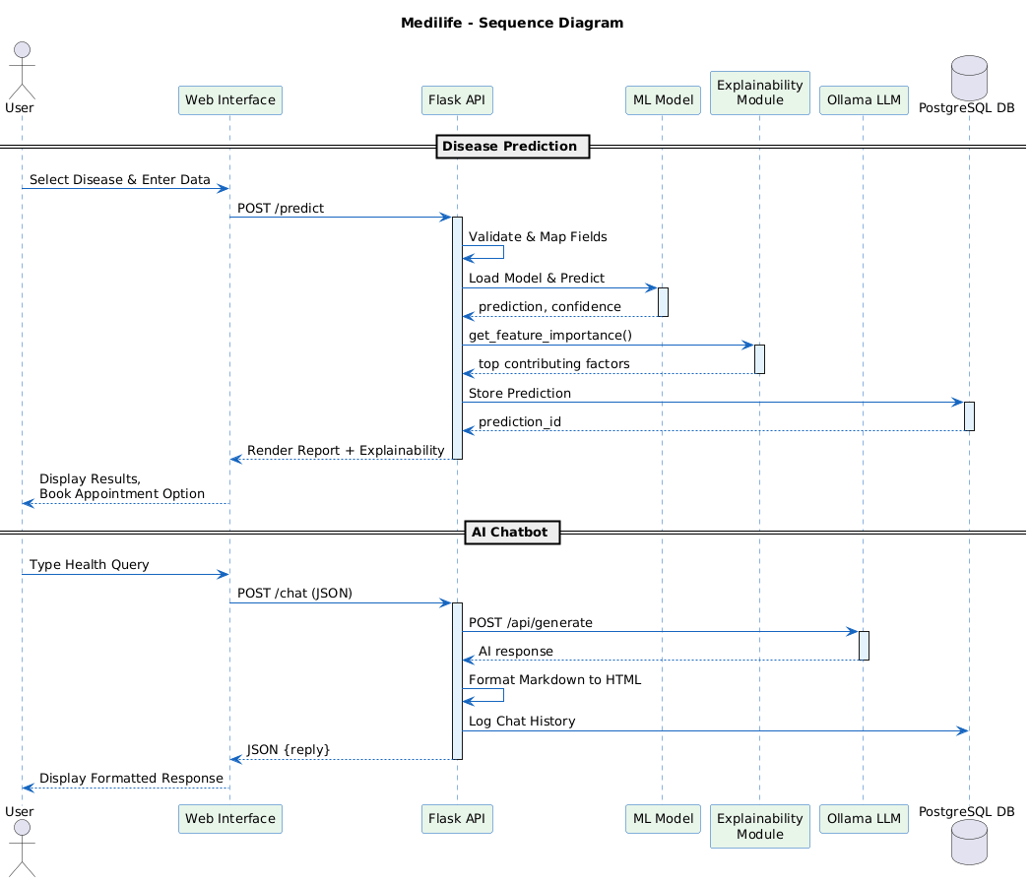
UML Diagrams
Sequence Diagram :

Slide 10
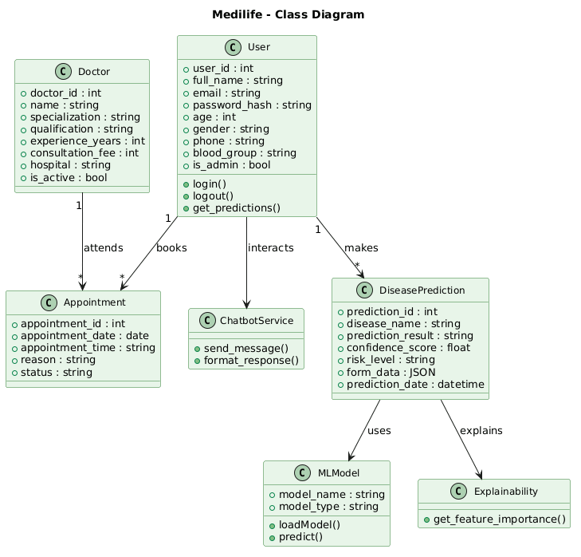
UML Diagrams
Class Diagram :

Slide 11
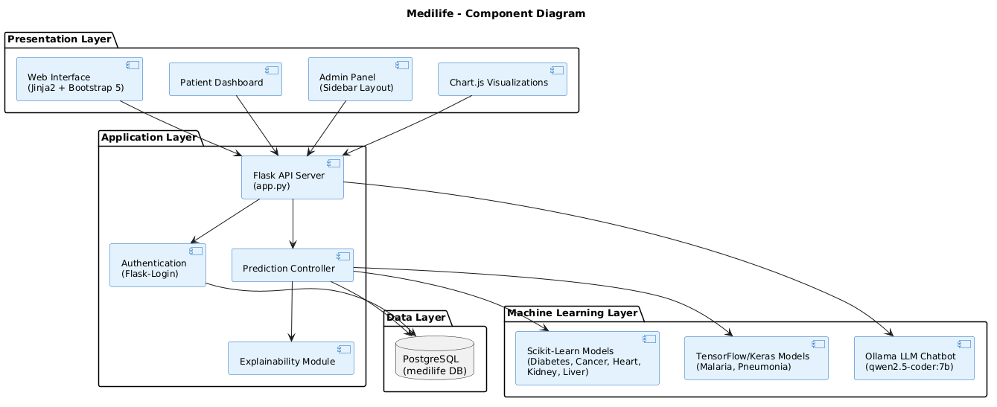
UML Diagrams
Component Diagram :

Slide 12
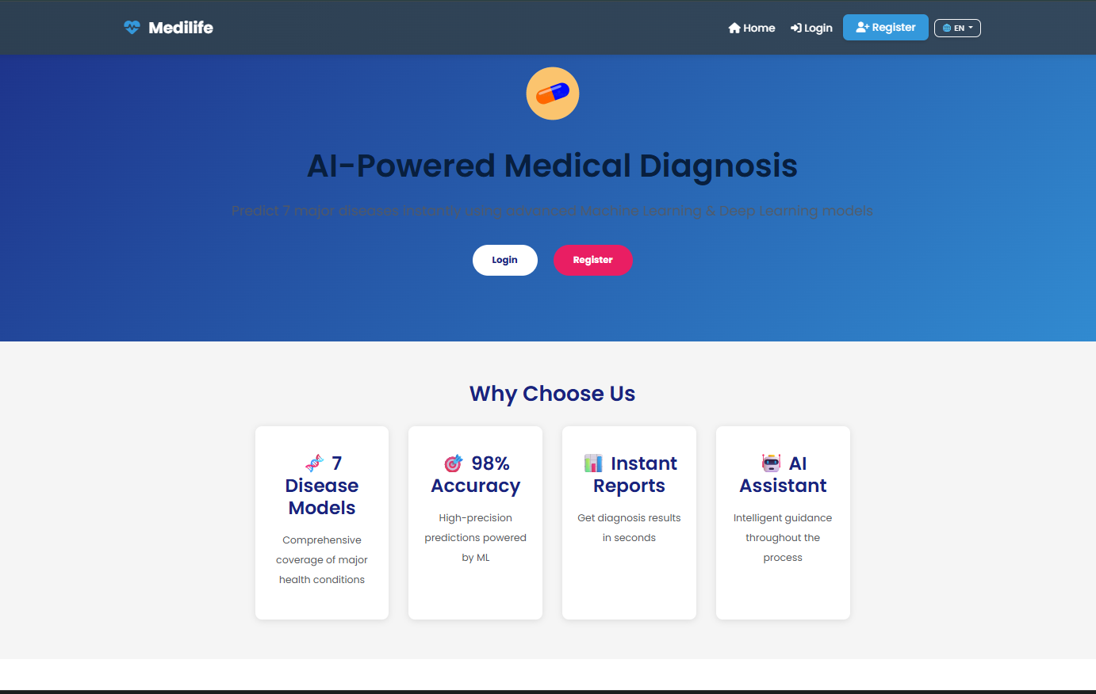
Medilife Layouts
Input Screens :

Slide 13
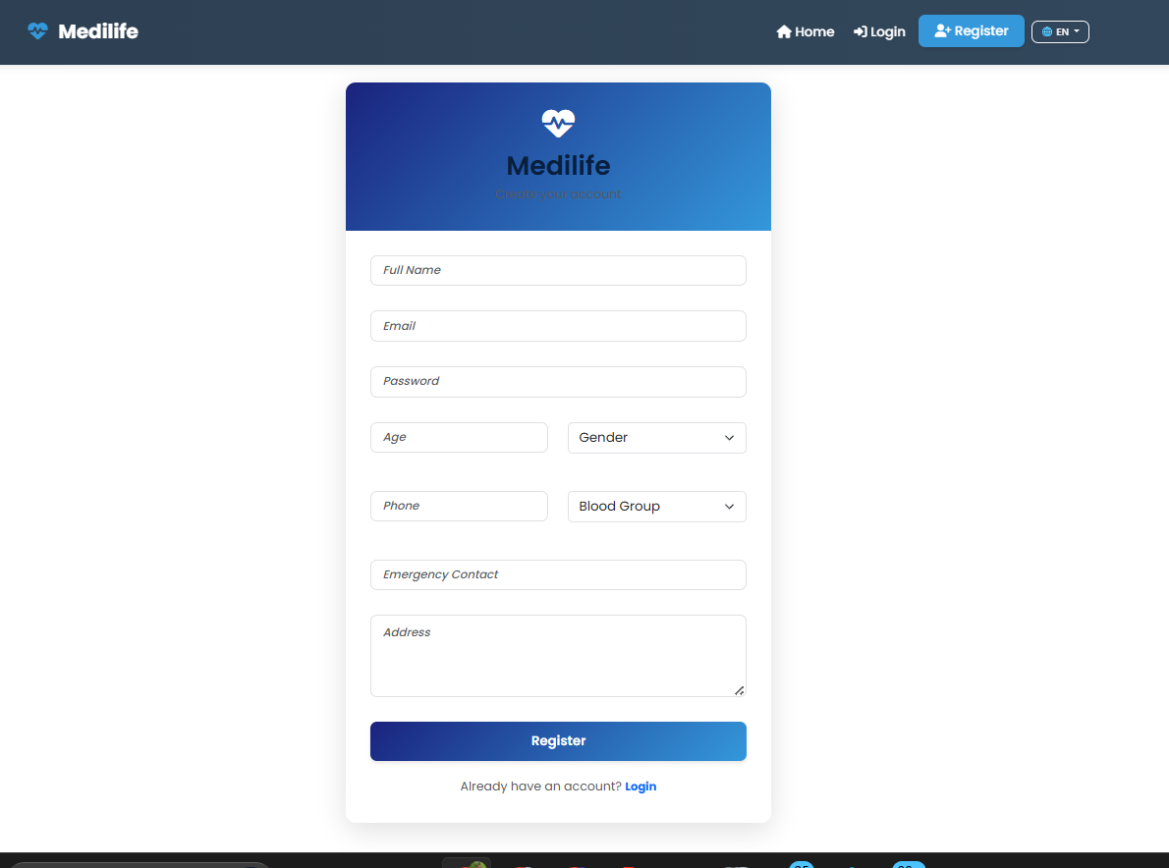
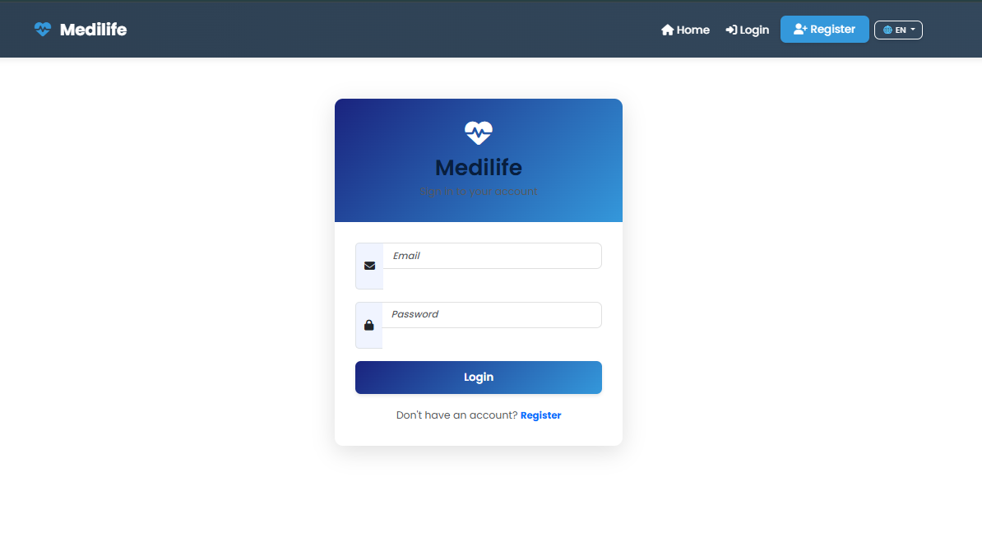
Medilife Layouts
Input Screens :

Slide 14
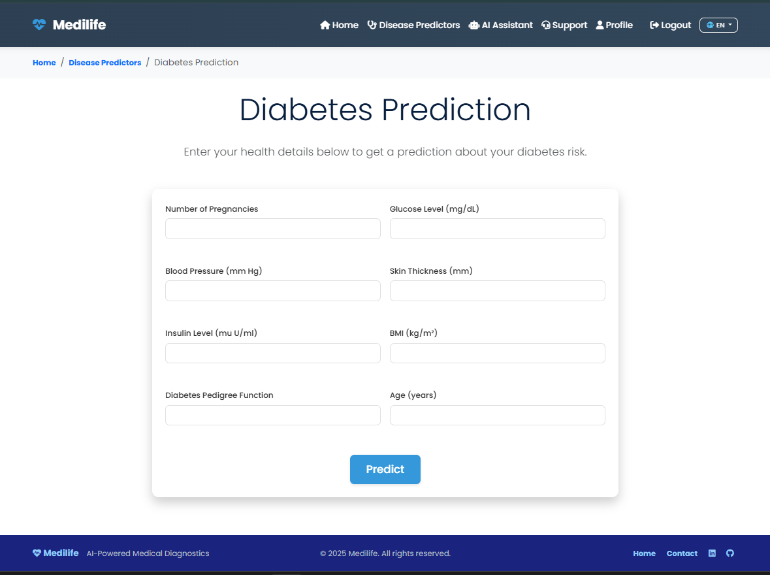
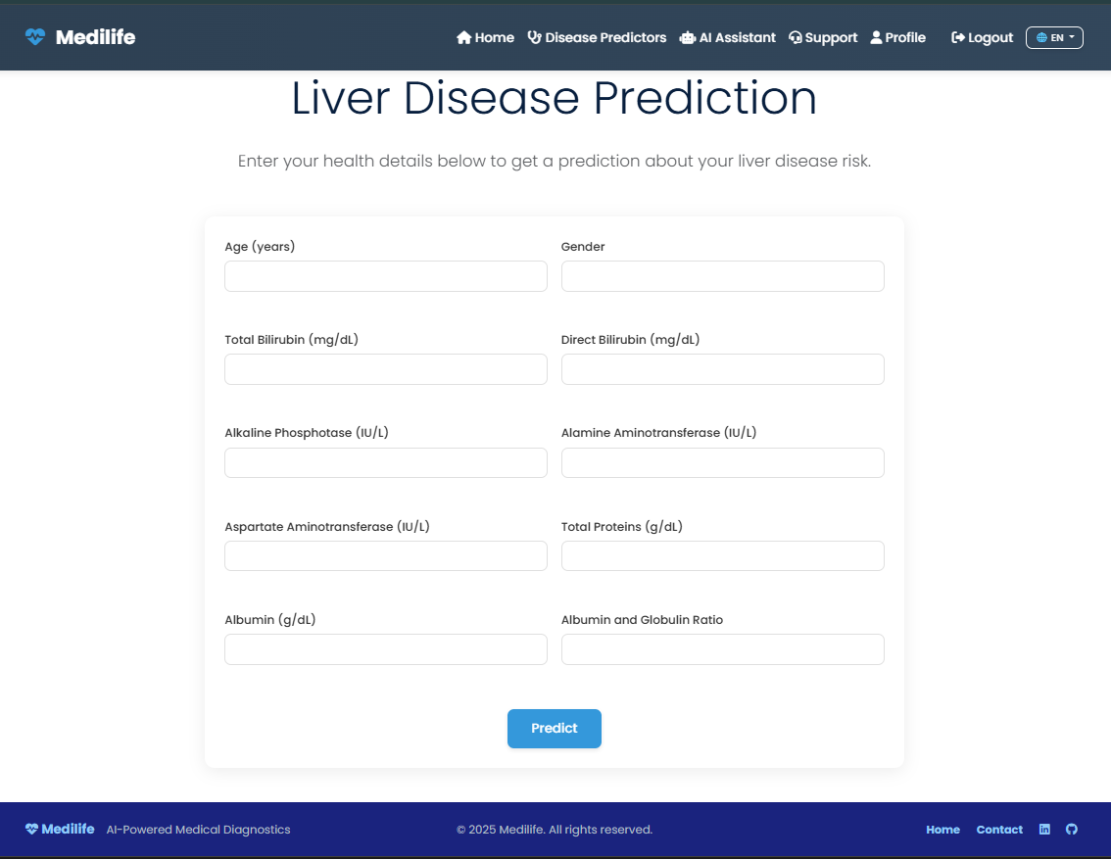
Medilife Layouts
Input Screens :

Slide 15
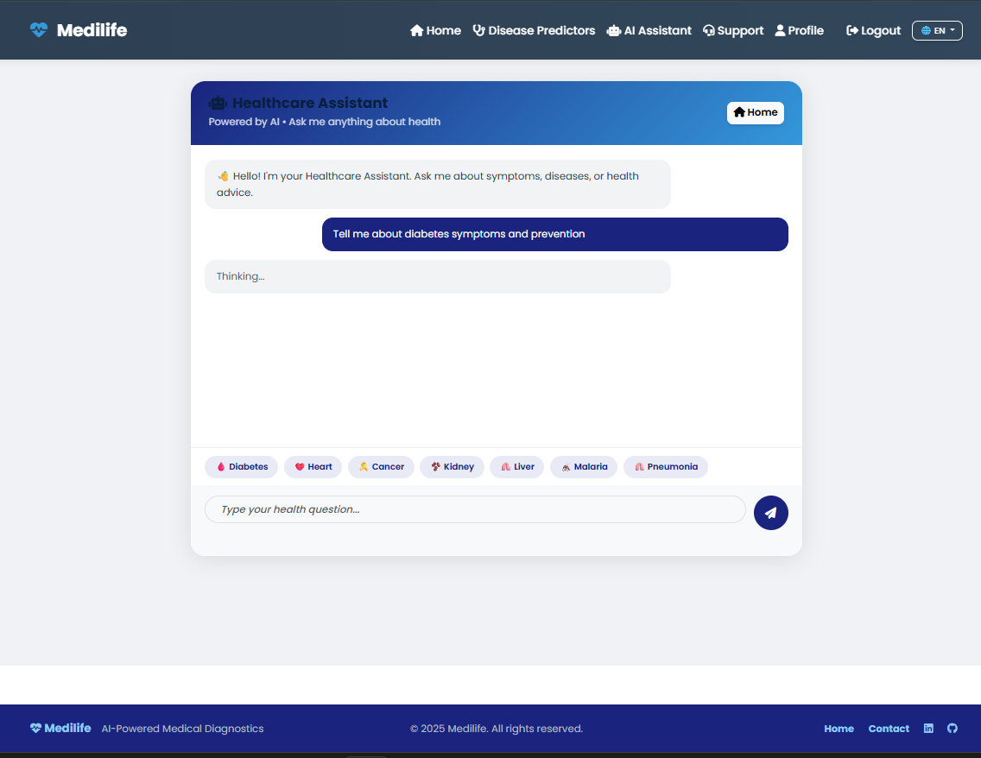
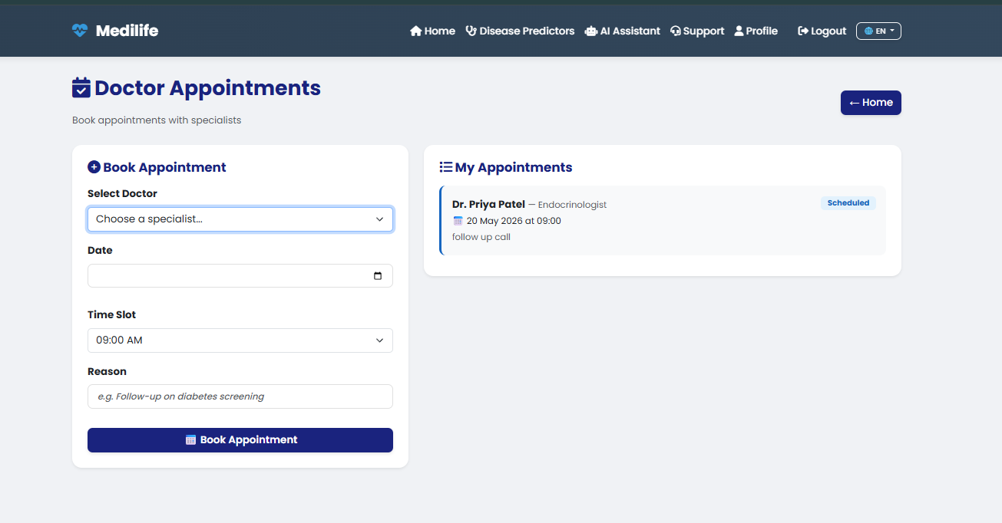
Medilife Layouts
Input Screens :

Slide 16
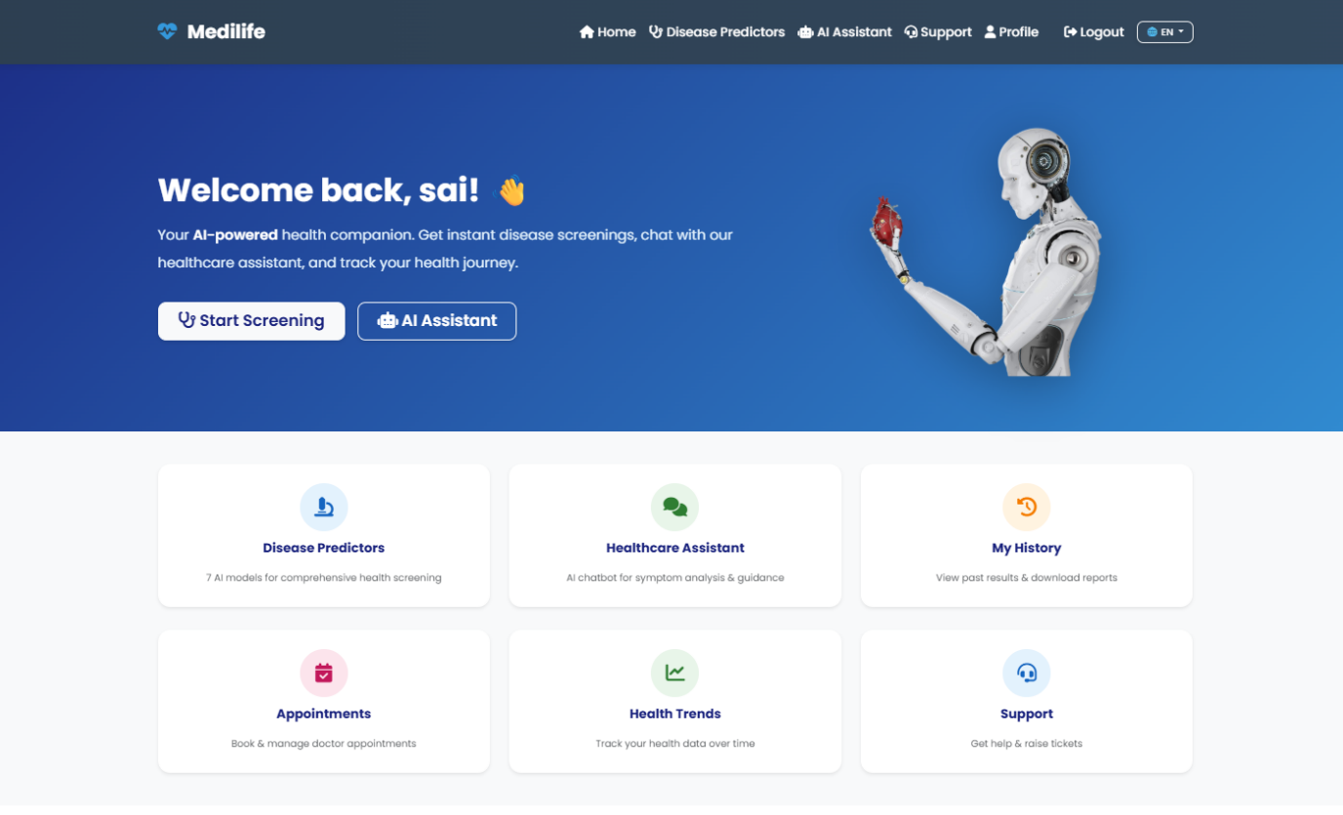
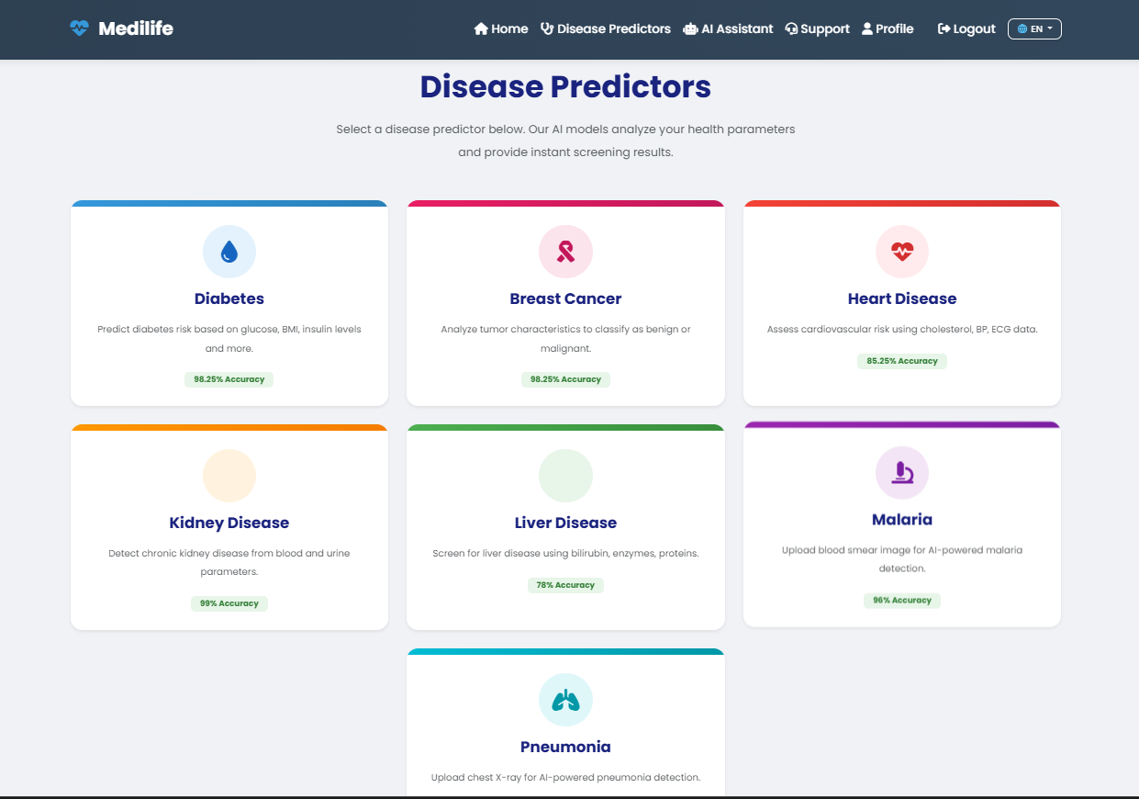
Medilife Layouts
Output Screens :

Slide 17
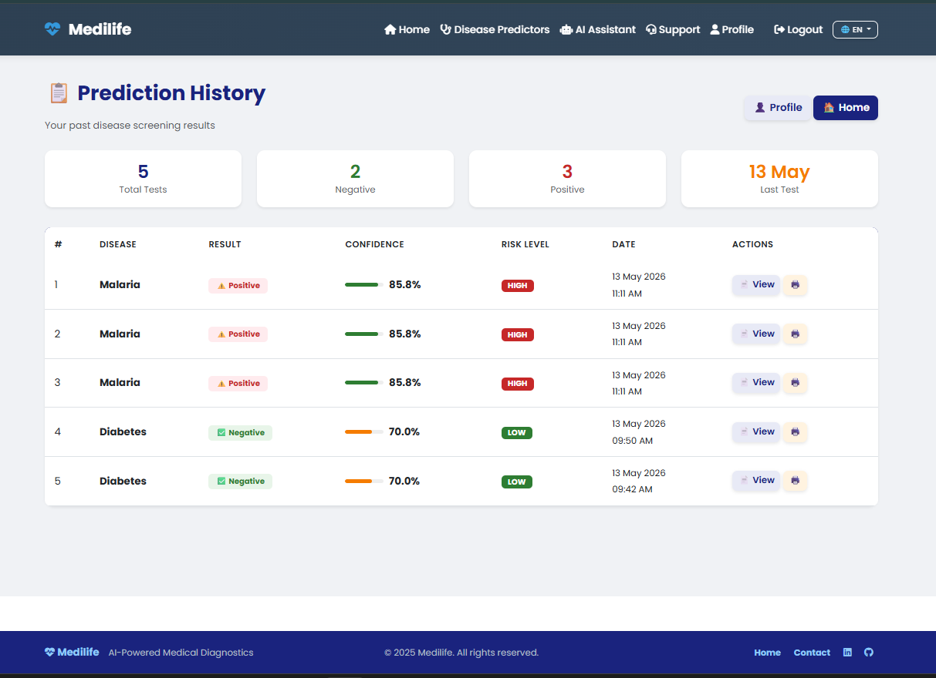
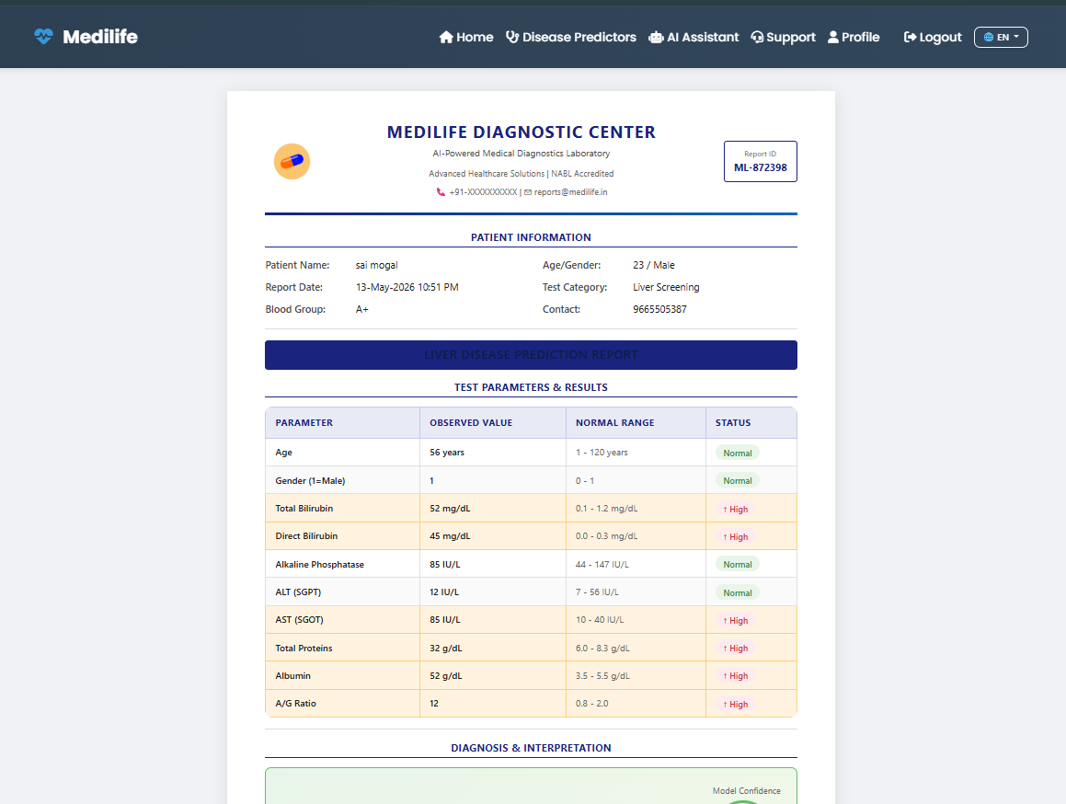
Medilife Layouts
Output Screens :

Slide 18
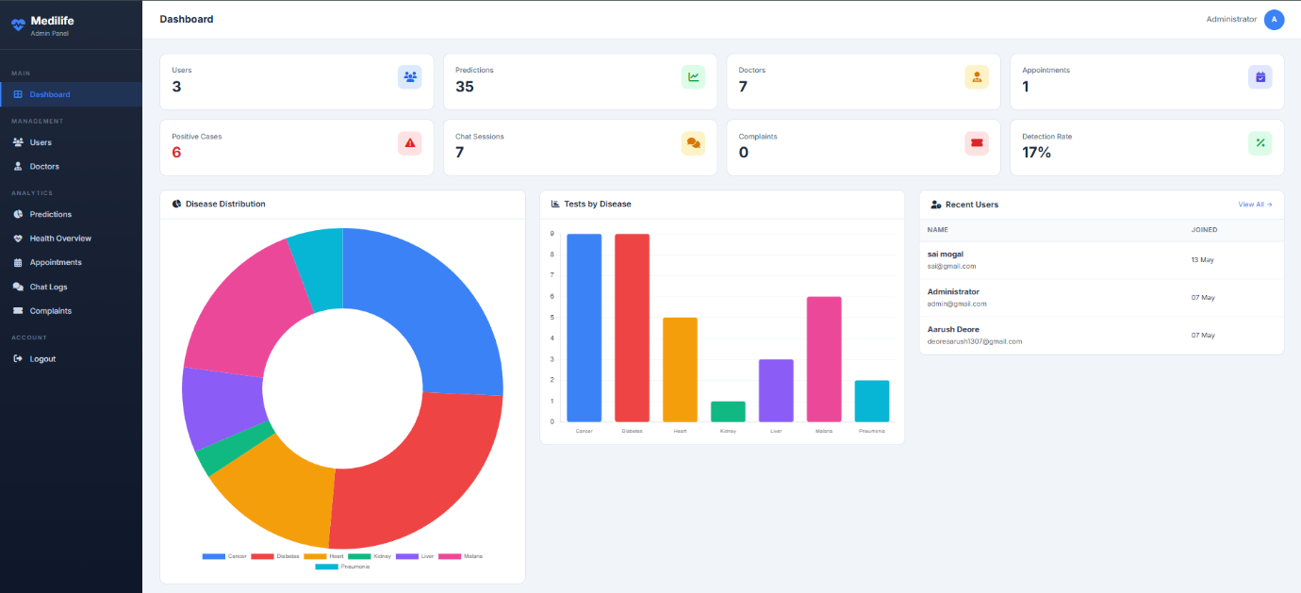
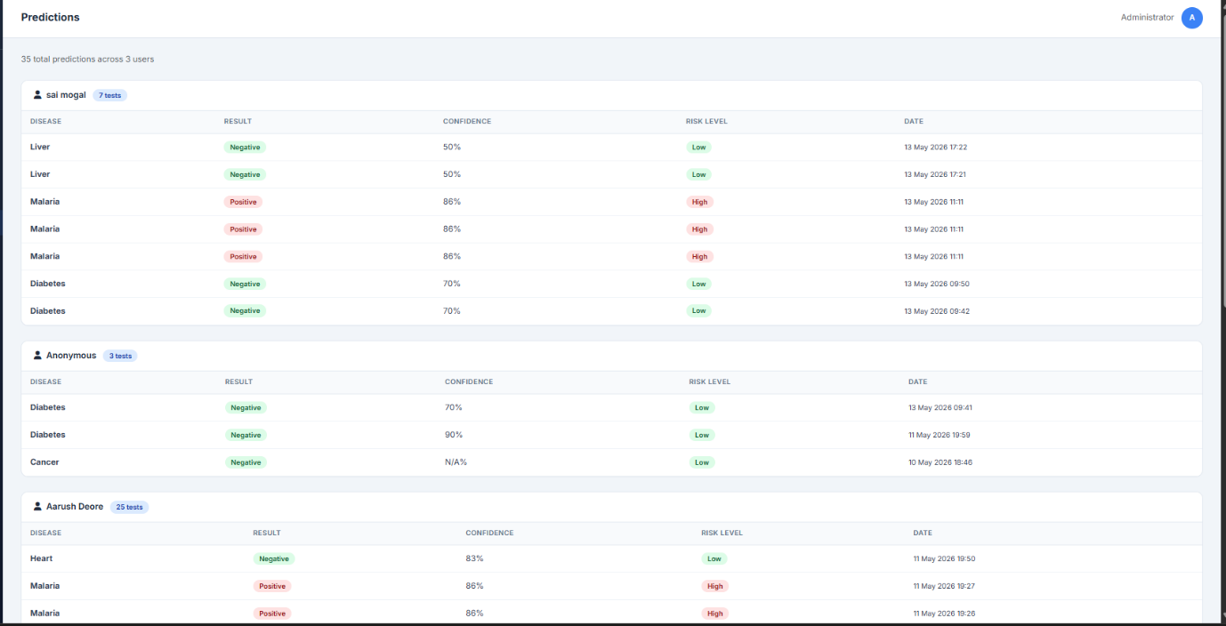
Medilife Layouts
Output Screens :

Slide 19
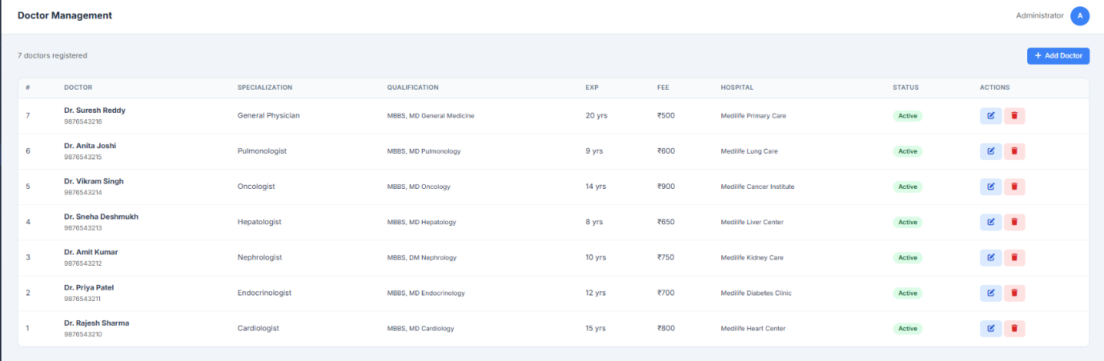
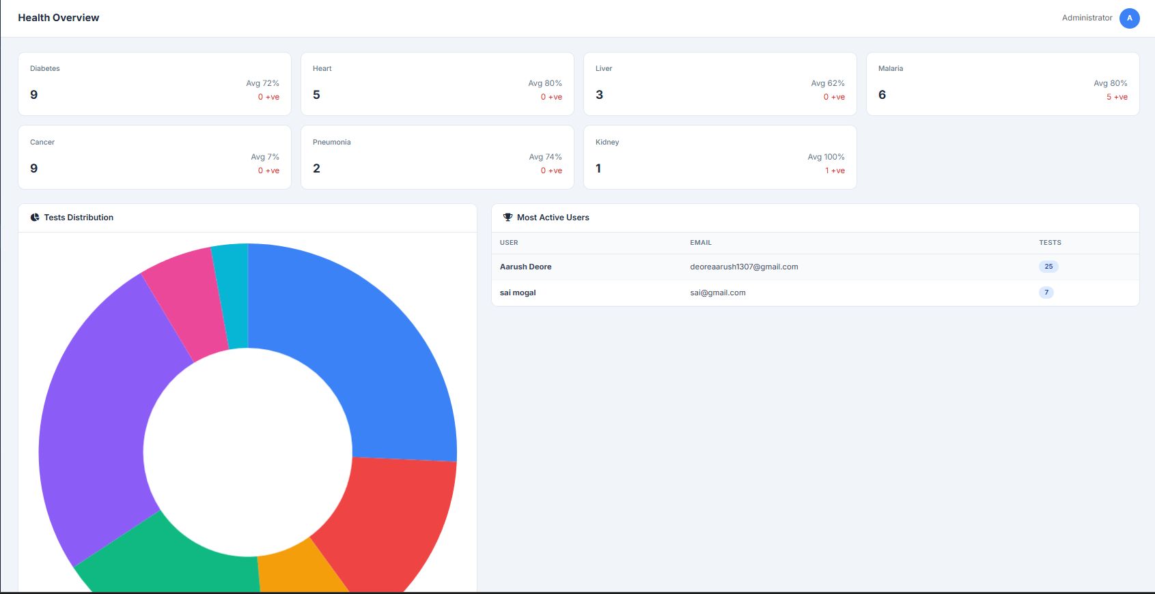
Medilife Layouts
Output Screens :

Slide 20
Future Enhancement:
Additional disease modules like brain tumor, skin cancer, dengue, tuberculosis, and thyroid disorder can be integrated.
Mobile application for Android and iOS to improve accessibility for remote area users.
Real-time patient monitoring using IoT devices and wearable sensors for health tracking.
Integration with Hospital Management Systems (HMS) and Electronic Health Records (EHR).
Enhanced chatbot using advanced LLMs and NLP for smarter healthcare guidance.
Telemedicine support with video consultation to connect patients with specialists remotely.
References:
Flask Documentation – Backend web development and API creation.
TensorFlow Documentation – Deep Learning and image classification.
Scikit-learn Documentation – Machine Learning algorithms and prediction models.
PostgreSQL Documentation – Database design and management.
Keras Documentation – Deep Learning model development.
NumPy & Pandas Documentation – Data preprocessing and analysis.
Research Papers on Medical AI and Disease Prediction.
Python Machine Learning – Reference for ML concepts.
Hands-On Machine Learning with Scikit-Learn, Keras, and TensorFlow.

Slide 21
Thank You…

